Slide 1
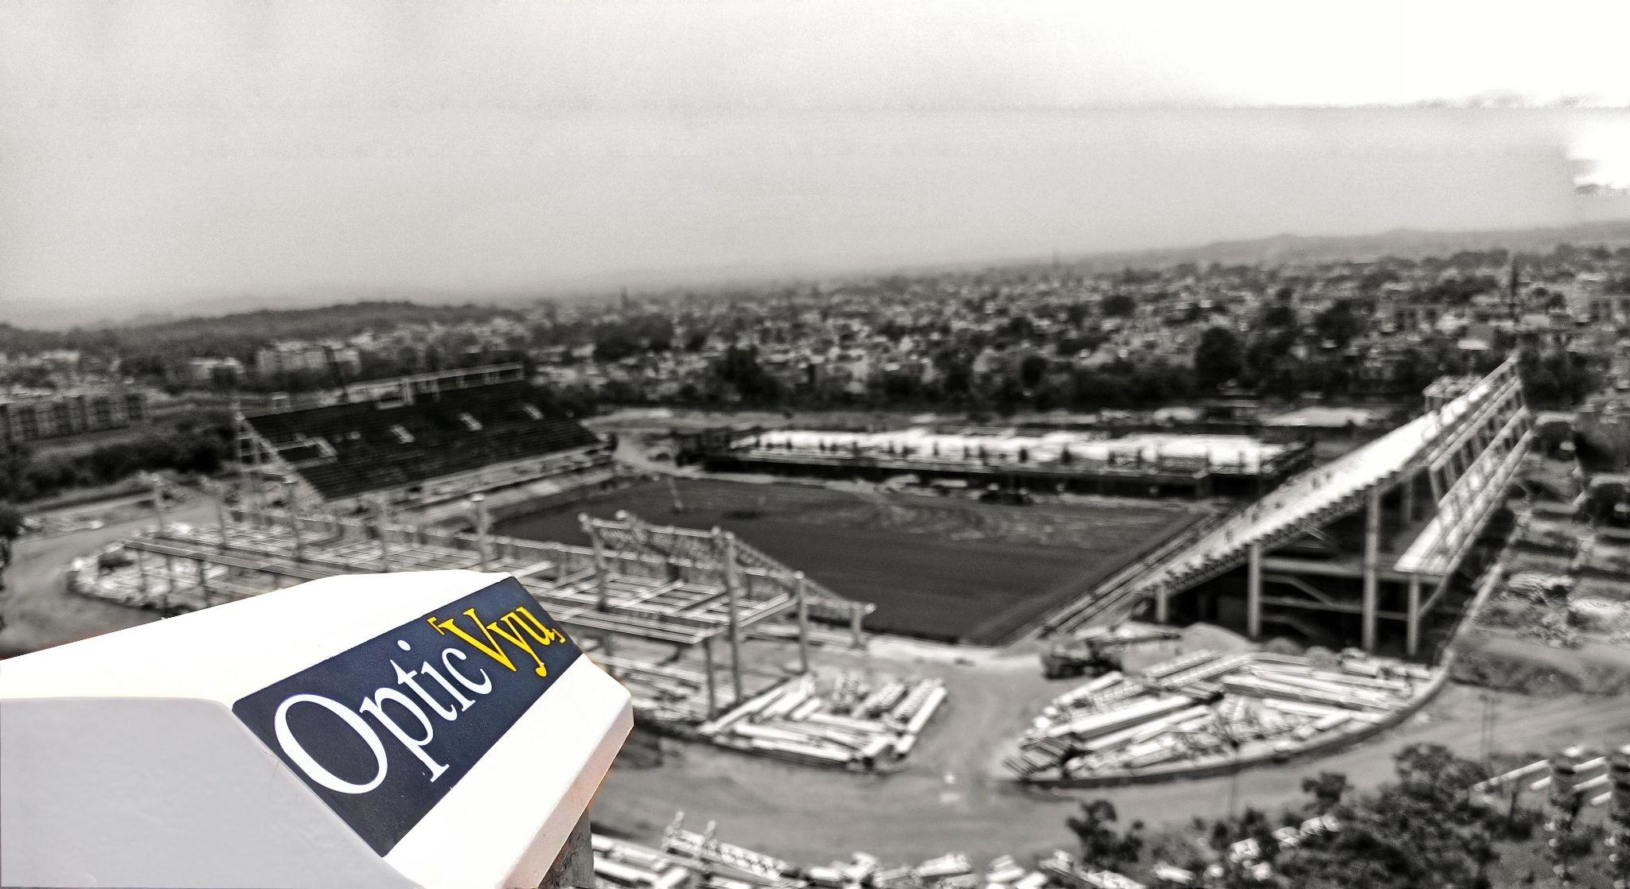
Time-lapse Based Construction Camera

Slide 2
Features of OpticVyu Construction Cameras
Project Tracking
Time-lapse Videos
Integration With Project Planning
Instant & Scheduled Reports
Weekly/Monthly Auto Time-lapse
Project Timeline
Image Tools
Archived Images – Unlimited Storage
Photo Comparison
Mobile/Tablet Photo Synchronization
Multi Project/Split Screen View
Image Annotation & Sharing
Admin/User Settings
Add Unlimited Users
Restrict/Manage Users
Auto-Email Alerts
Marketing
Unlimited Custom Time-lapse
Publicly Accessible Open Access Page

Slide 3
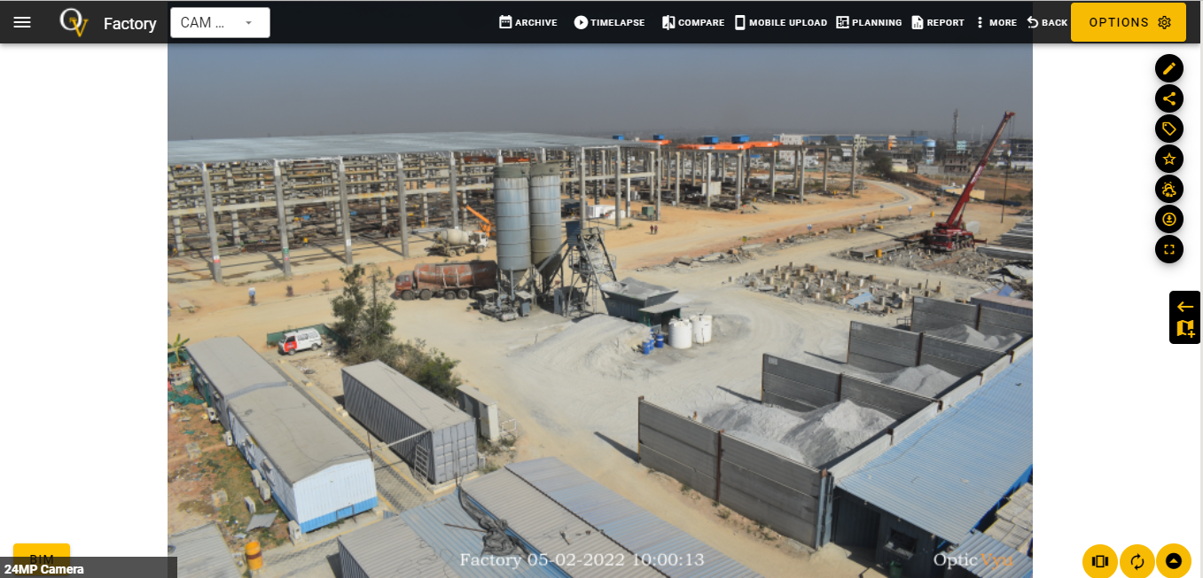
Dashboard Overview

Slide 4
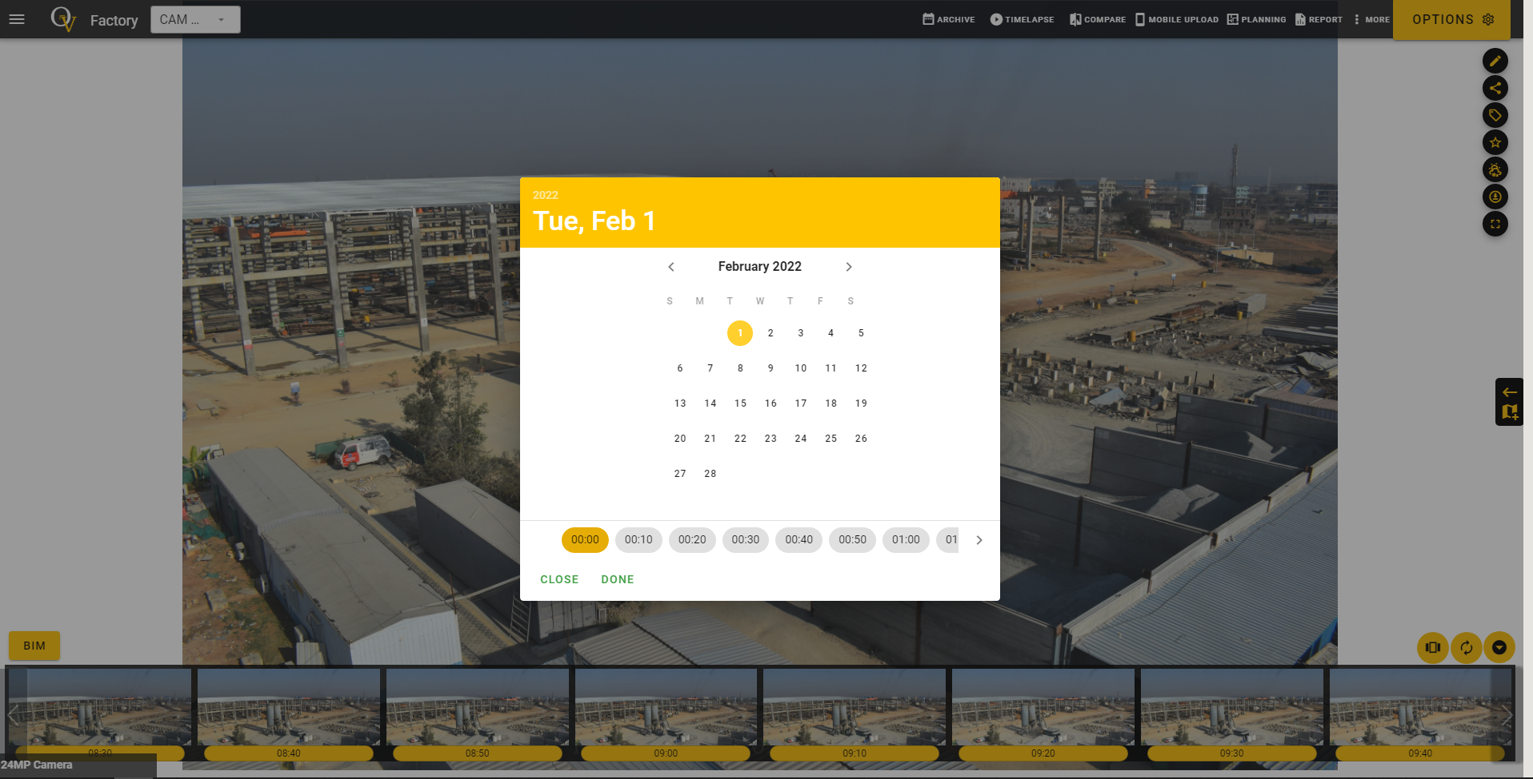
Archived Images
Access all the past dated images

Slide 5
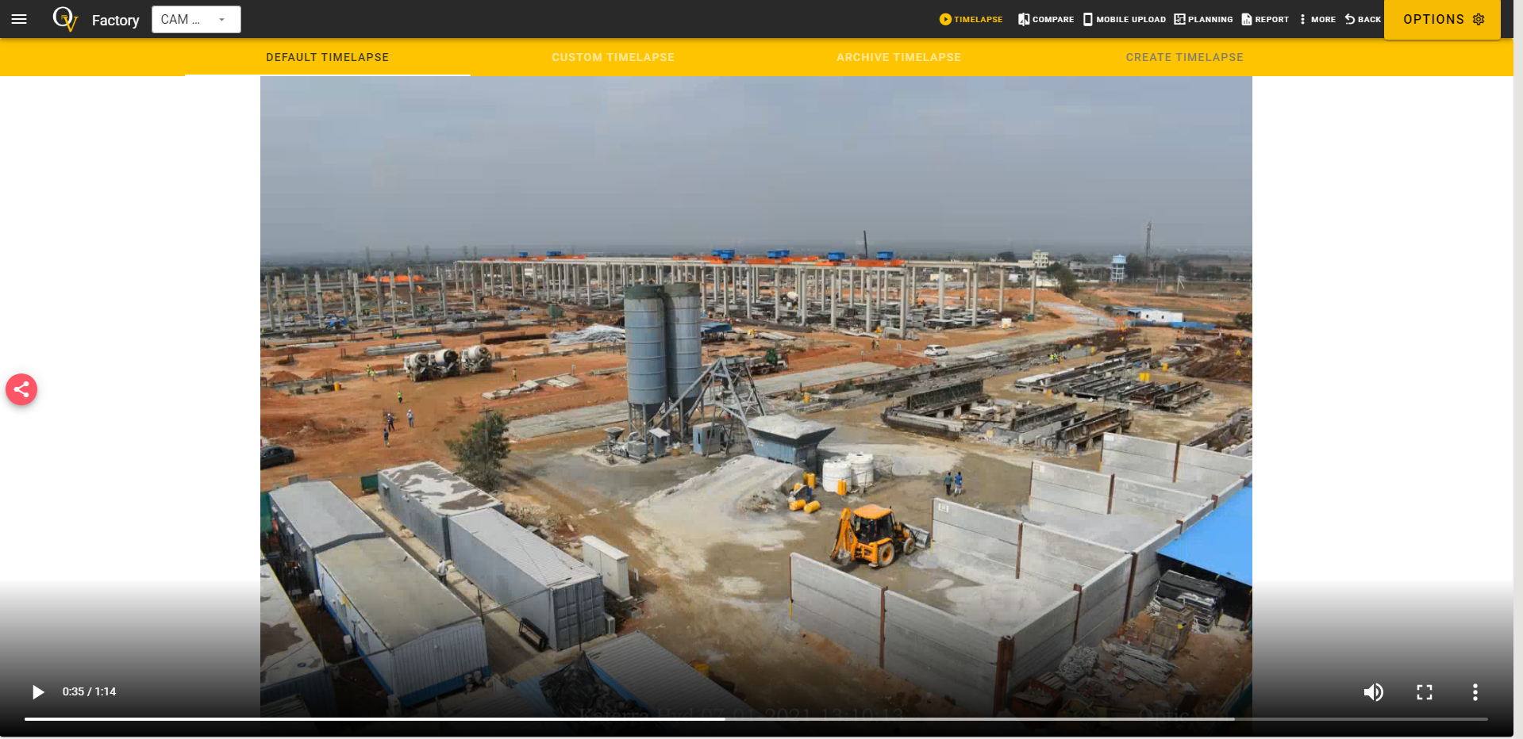
Time-lapse Videos
A video showing overall construction progress in a few minutes.

Slide 6
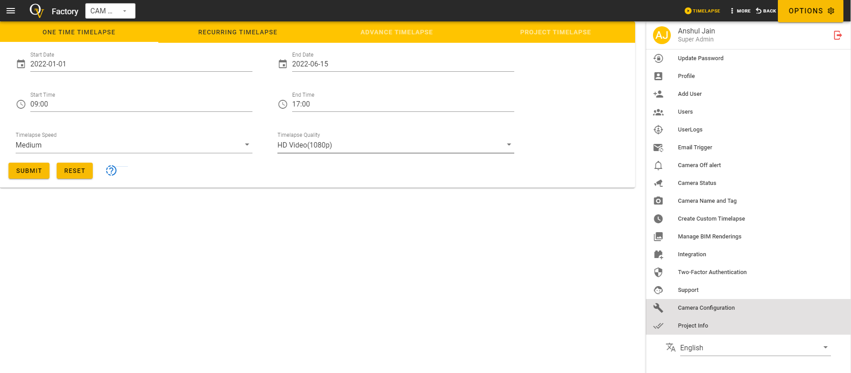
Custom Time-lapse Videos
Customize time lapse as per your requirement by selecting suitable date, time, video speed & quality

Slide 7
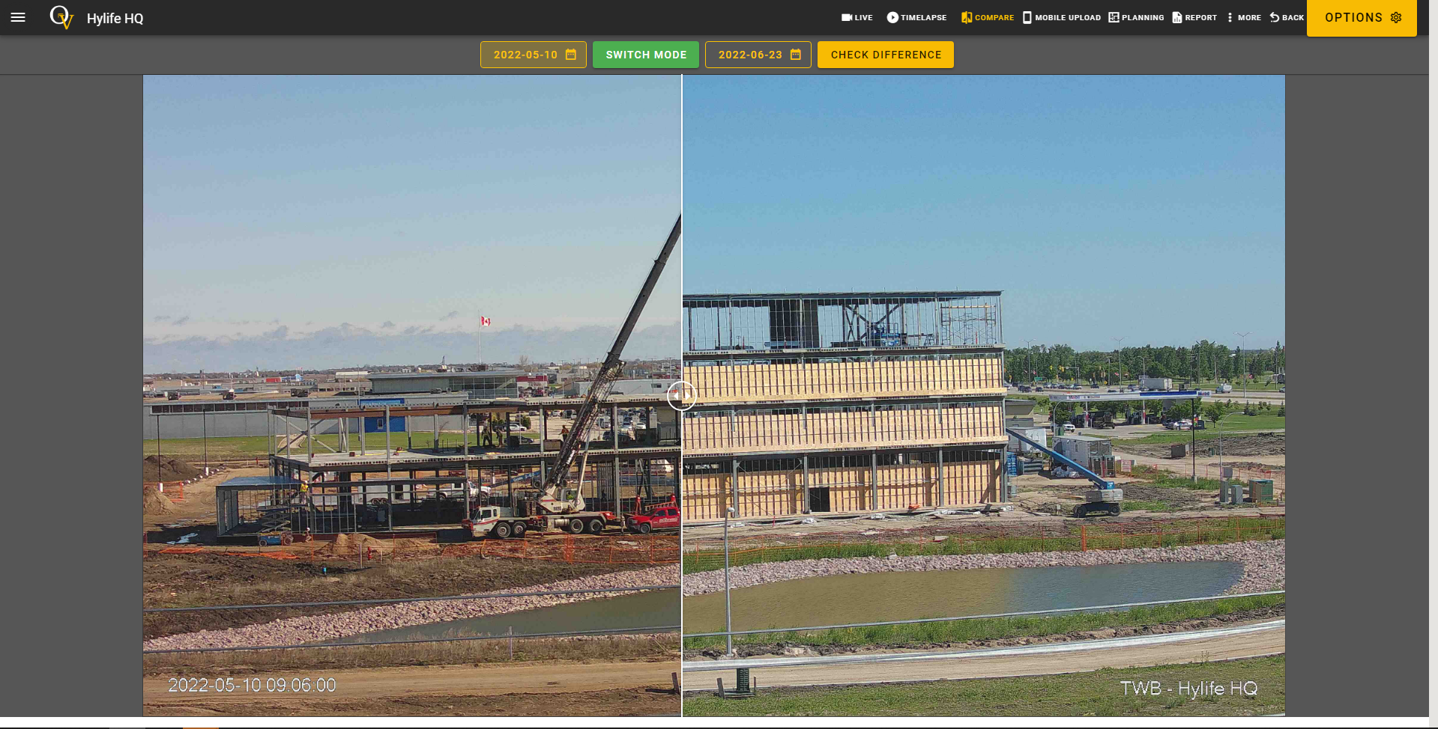
Photo Comparison
Compare images captured at different instances to check the actual work progress.
Images can be compared in slider view or in split view.

Slide 8
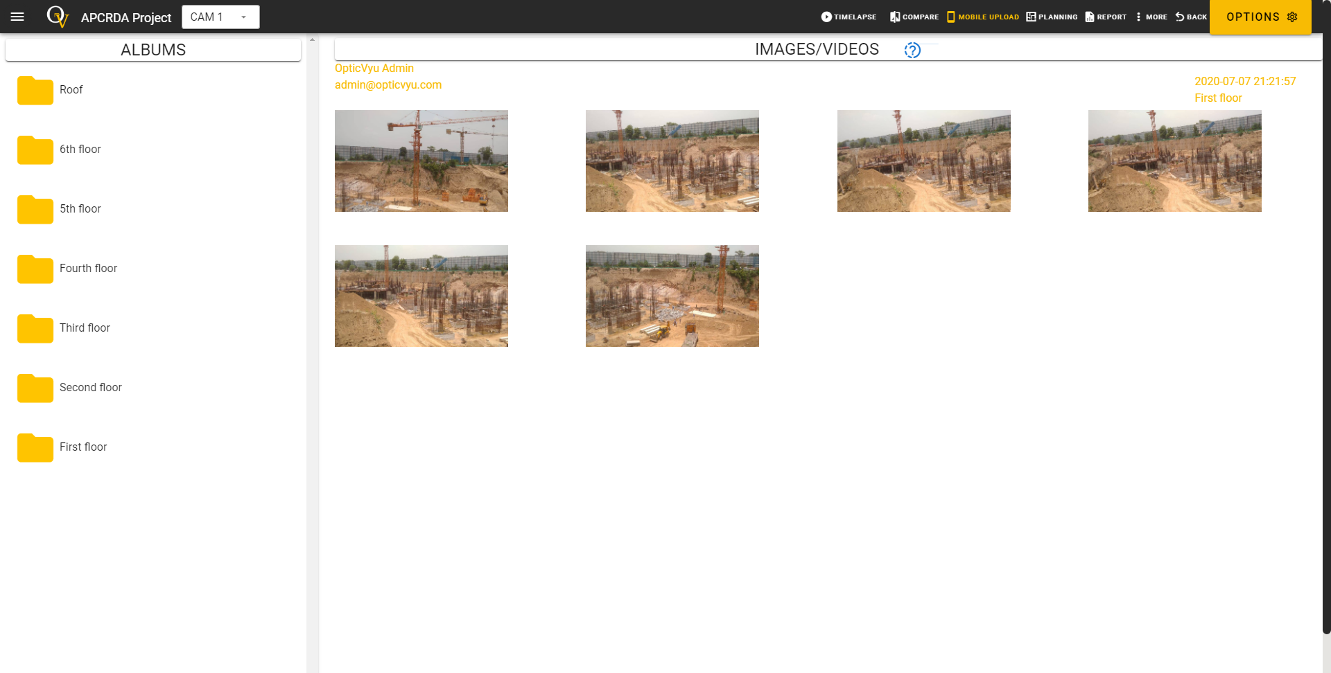
Mobile Photo Synchronization
Capture, edit and upload jobsite images & videos using OpticVyu android mobile application

Slide 9
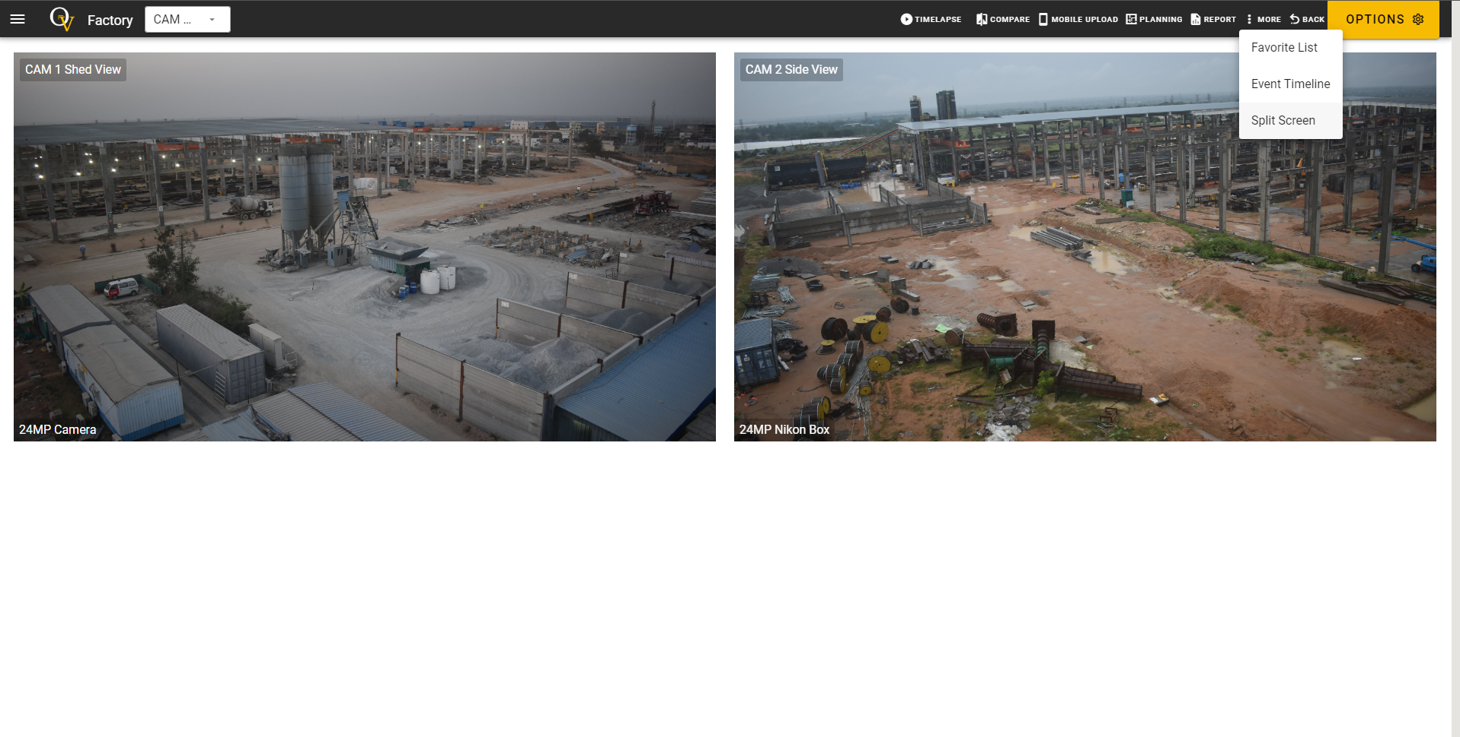
Split Screen View
View multiple camera feeds on one screen

Slide 10
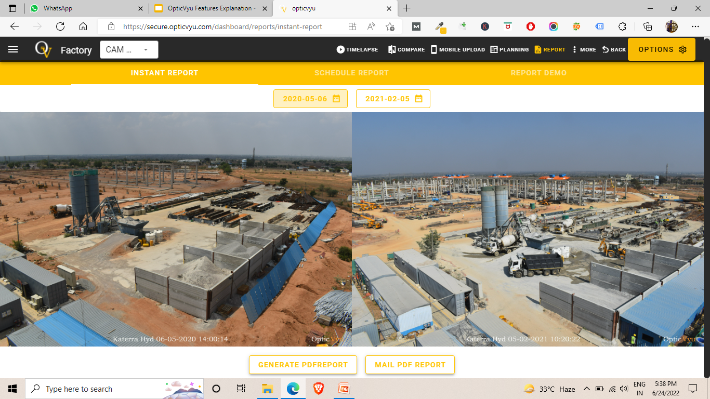
Reports : Instant Report
Select two images to create, download, or email the pdf report. Click here for video explanation
Sample Instant Report
Sample Detailed Report

Slide 11
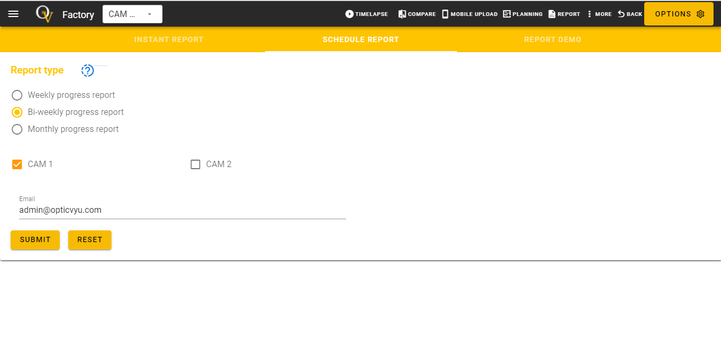
Reports : Scheduled Report
Schedule a report to receive regular progress reports in emails.

Slide 12
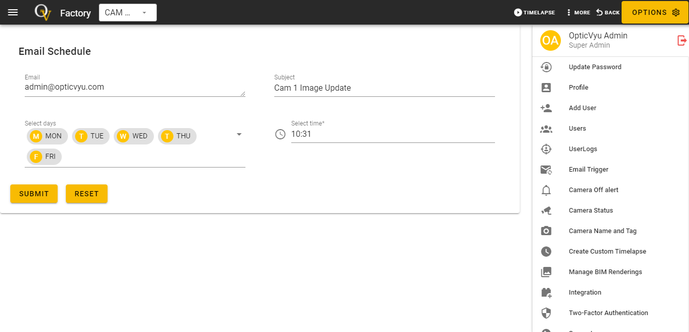
Auto Email Scheduler
Receive email alerts with latest image attachment to pre-configured email at pre-configured time

Slide 13
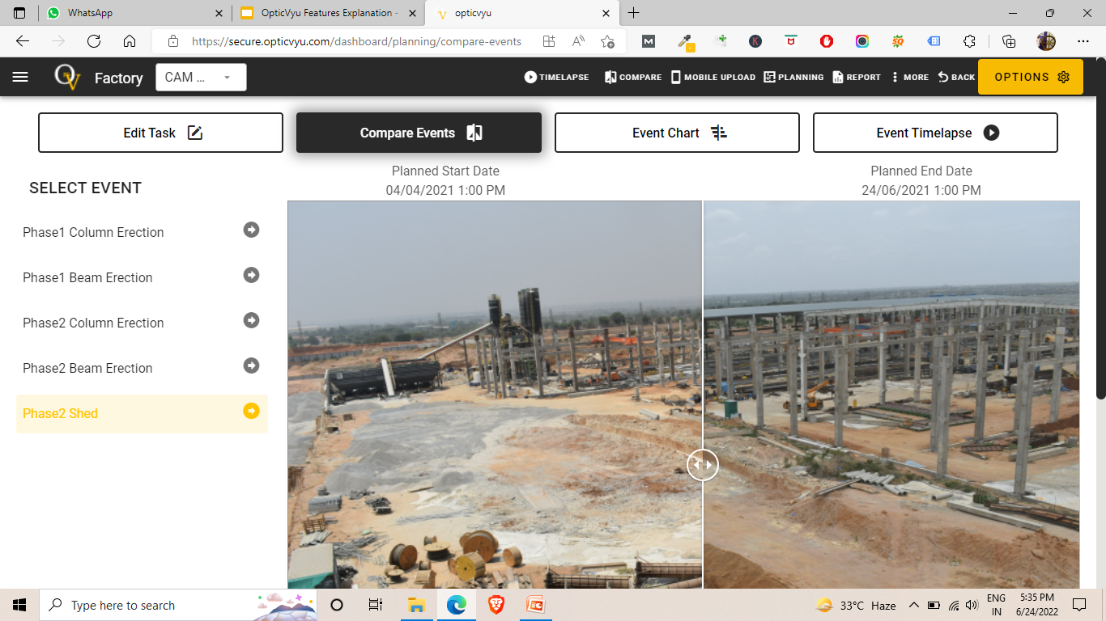
Project Planning Integration: Compare Events
Upload planning data to OpticVyu and compare images corresponding to event’s “Planned start/end dates”
Select images for other date, inspect & mark them to “Actual start & end dates” for a given event.

Slide 14
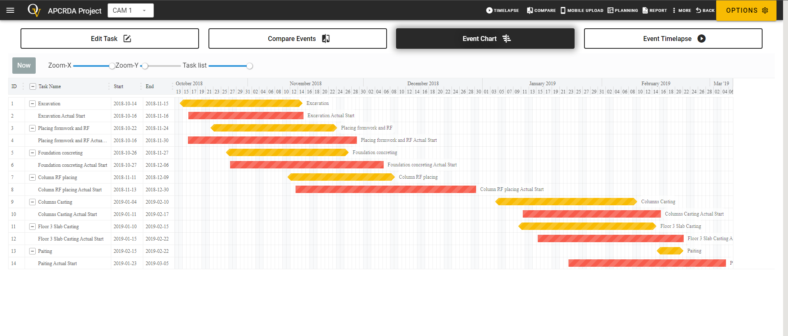
Project Planning Integration: 2 Event Chart
Once the actual start/end dates are updated on “Compare Tasks Page”, user can check “Event Chart” showing planned/actual start/end dates and delays

Slide 15
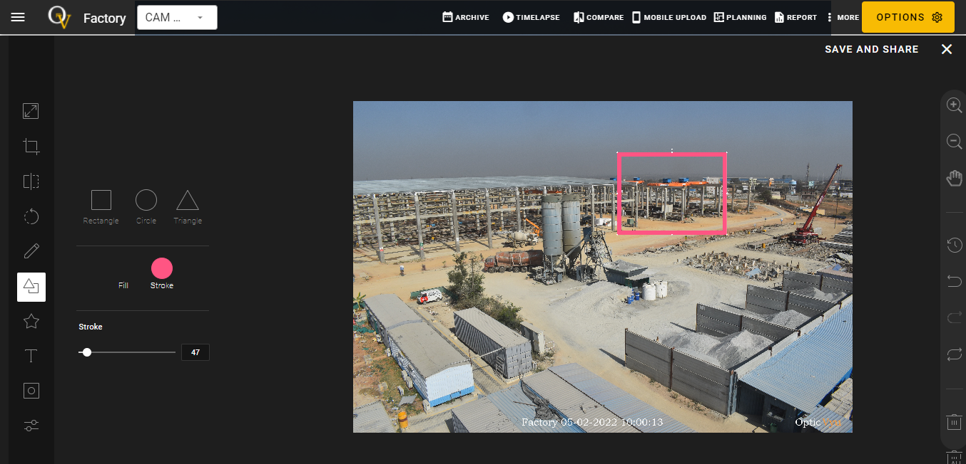
Image-Tool : Markup & Share
Markup an image, highlight the issues & share it via email.

Slide 16
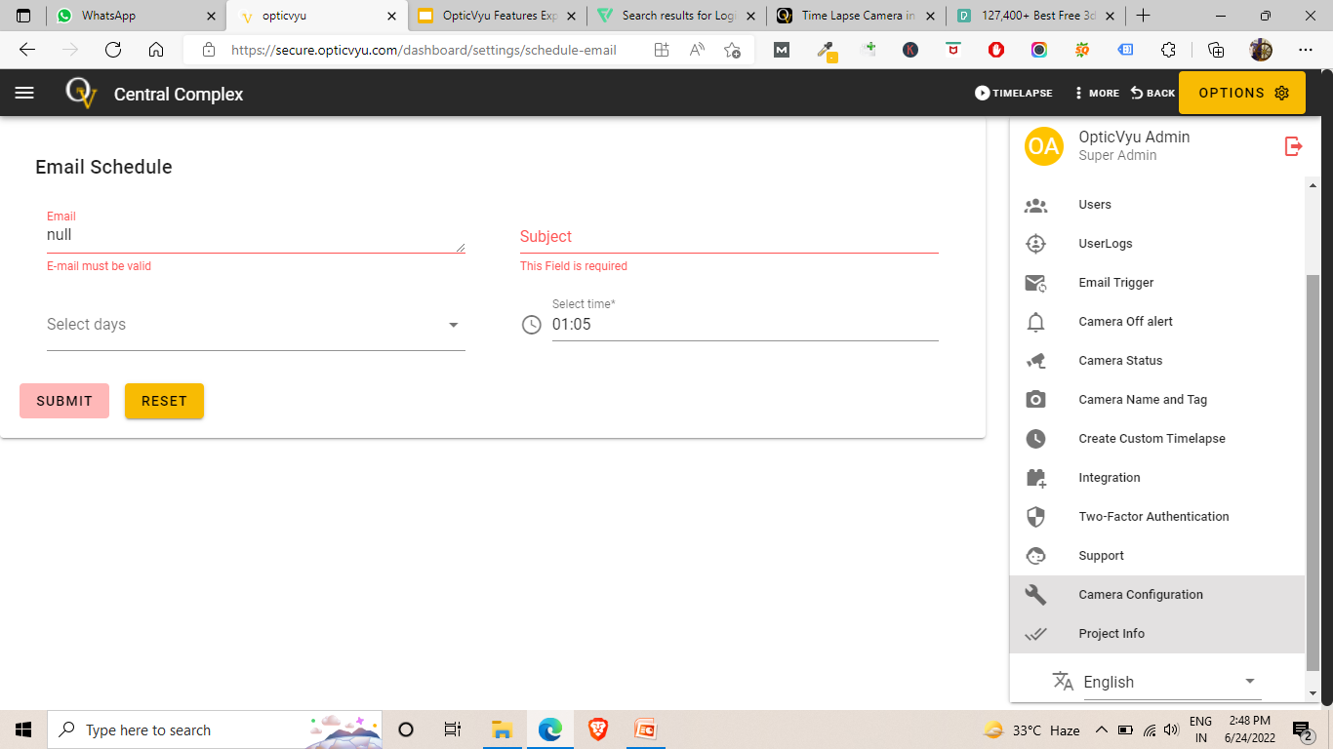
More Setting Options
Manage all the users who has the access to your projects
View the user logs (device, date and other login details)
Set auto trigger email for a project camera at particular time
Setup email alert when a camera goes off
Check status of cameras (on/off)
Edit camera name and tag (visible on dashboard)
Create different types of custom time-lapse
Integrate OpticVyu dashboard with BIM, Procore, & Project Planning
Enable 2-way authentication for more secure login
Contact OpticVyu support team
Configure details to show on dashboard
Project information can be accessed from here
Multi-language options

Slide 17
Products
45MP DSLR Box Time-lapse Camera
OpticVyu Make
24MP DSLR Box Time-lapse Camera
360-Degree Image-Based Long Term Time-lapse Camera
4MP & 8MP Time-Lapse Camera - Basic Mode
4MP & 8MP Time Lapse Camera - Image + Video Dual Mode
PTZ Time-Lapse Camera
Integrated With CCTV Cameras
OpticVyu can be integrated with any IP camera. Refer next slide.

Slide 18
Integration With Existing CCTV
Get Connected to OpticVyu
Email us at admin@opticvyu.com
with the details of CCTV
cameras installed in your
Facility
Done. Login
Visit OpticVyu website &
login through registered
ID to access camera feeds
& time-lapse videos.
Existing CCTV
Any IP camera can be
connected
Online Integration With OpticVyu
OpticVyu request an online access to
PC/Laptop connected in the same network
as CCTV for uploading configuration.

Slide 19
Comparison With CCTV
Features | OpticVyu Construction Camera | CCTV Camera
Storage | Unlimited storage | Monthly storage
Data Backup | Instant data backup to dual server | Storage only on hard disk
Data Retrieval/Access | Data from any point of time can be accessed in seconds | Data (if not saved on hard disks) will be permanently erased
Clarity | HD clarity can be achieved by using DSLR box camera | Videos are reduced to .h264 compression format to reduce video quality and size
No. of Camera | Mostly 1-2 cameras are sufficient to cover entire site if placed at good location | Typically 4-6 CCTVs are required to cover a big construction project
Time-lapse | Default and custom time-lapse possible | No time-lapse
Ease of Installation | Plug & play system | Require wiring/cables/connectors/LAN
Internet Connectivity | In-built wifi based on SIM network (min 3G required) | LAN or external wifi needed to stream the video
Ease of Relocation | Simple to relocate frequently | Laborious task to change wiring/cabling etc.
Reports Generation | Possible | Not possible

Slide 20
Advantages of OpticVyu Construction Cameras
Progress documentation through automated reports
Integrate Construction Monitoring with Project Planning
24x7 Monitoring of Remote Projects With Low Internet Bandwidth
Check Construction Progress Through Time-lapse Videos
Coordinate with Teammates by Sharing Annotated Images/Setting Auto Emails
Create Event/Activity Based Time Lapse Videos
Customize Time-lapse Videos for marketing
Synchronize Mobile Photos with OpticVyu Dashboard
Create Charts For Planned & Actual Start/End Dates for Various Events. Check Delays
Handle Numerous Projects & Cameras From One Platform.
Keep Years of Monitoring Data Stored For Future Ref.
Check Construction Progress Between Two Time Instances

Slide 21
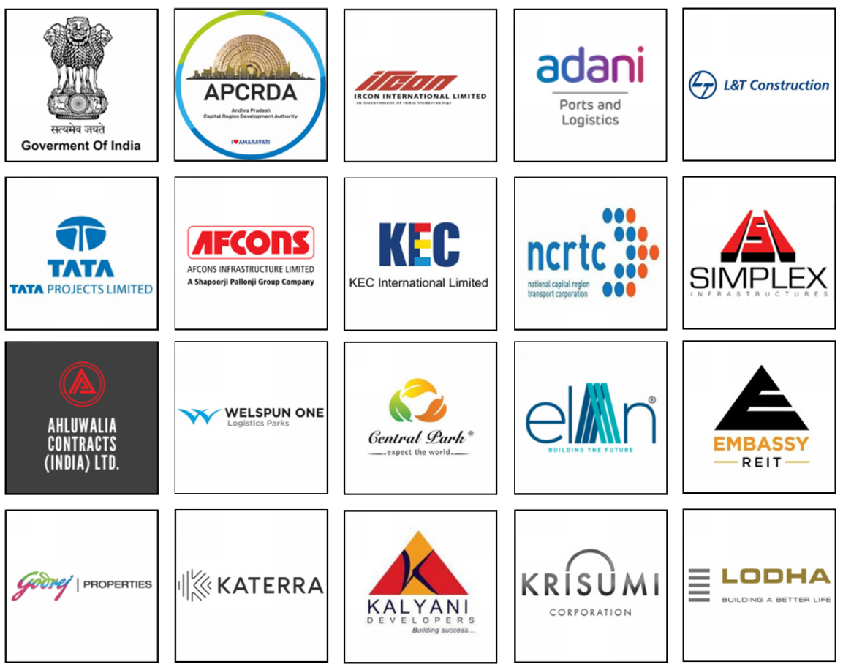
OpticVyu Clients

Slide 22
Important Links
Website
Presentation, demo videos, portfolio, user manuals, products etc.
Quick walk-through video
Sample time-lapse
OpticVyu portfolio (clients & projects)
Features demo
FAQ

Slide 23
Thank You
Anshul Jain
Anshul.jain@opticvyu.com
Founder, OpticVyu
Alumnus, IIT-B
Nitesh Patel
Nitesh.patel@opticvyu.com
Co-Founder, OpticVyu
Alumnus, IIT-R
Contact: admin@opticvyu.com

